Slide 1
Learning To Create automated tests
Darrell Grainger - Quality Analyst
dgrainger@thoughtworks.com

Slide 2
How to approach automation
When I learned a new language, e.g. French, I thought in English and converted it to French
After a while I started thinking in French
I approached automation the same way
I knew how to create a manual test case
I just needed to figure out how to convert it to programming
After a while, I’d start thinking about the test case as a set of programming steps rather than manual steps
Until that happens, I recommend writing out a test case in your native tongue then converting it to programming automation

Slide 3
How to get a project started
Test automation is programming.
So basic programming practices are part of writing automation
So you should know the following:
Having good tools to develop with (IDE, compiler, etc.)
Using source control (usually Git but some still use CVS or SVN)
How to program in the test automation language
Frameworks which help with test automation (unit frameworks)
How to use a shell (important for adding to a build pipeline)
For this presentation I’m going to use Git, Java and Selenium
For a good shell see the checklist at the end of this presentation

Slide 4
Java development kit
Your computer might have Java already installed
If it does not go to the Java website and download the latest version of JDK 8.0
You’ll need the full JDK and not just the JRE (Java Runtime Environment)
Do not download version 9.0 or 10.0
Selenium currently works with Java 8.0
Current version of Java, 8.0 build 181: http://www.oracle.com/technetwork/java/javase/downloads/jdk8-downloads-2133151.html
See the list at the end of this presentation for the link to Java

Slide 5
Java development tools
There are a few good, free Java development tools
Most are called Integrated Development Environments or IDE
Some tools are completely free and have to paid version
Others have a community edition for free and something with more features for paid
I prefer to use the community edition because often companies will opt for the paid version
So you can build on what you learned from the community edition
I like Intellij IDEA from Jet Brains
You can download it from https://www.jetbrains.com/idea/

Slide 6
What does a good ide do for you?
When you start developing a Java application in say notepad then you need to know the following:
The syntax of the language
Which import statements you need
How to include a library and where to download it from
Help on using methods and classes
With something like Intellij, it will help you with these things
For example, to print something I’d use System.out.println()
In Intellij I’d just enter: sout and it would expand to the full command
You’ll learn more as we go along

Slide 7
Source control - where to get git from
macOS
If you are using a macOS computer then it comes with Git installed
Windows
If you are using Windows you’ll need to install Git
I’d recommend a version of Git which comes with a Bourne shell
If you can use Git for Bourne shell you can use it on Linux and macOS
Download it from: https://git-scm.com/download/win
Linux
It depends on your Linux distribution
It might already be installed
If not, you’ll have to figure out how to install packages and add Git

Slide 8
Source control
When you create test automation it will take weeks, possibly months to create everything
How do you save your work each day?
You can make backups but restoring a backup can be difficult
This is where source control is helpful
It is sort of like creating backups in an organized and easy way to restore
To get started, we’ll use GitHub
Go to https://www.github.com and create a free account
Once you have an account and are logged in we’ll create a repository

Slide 9
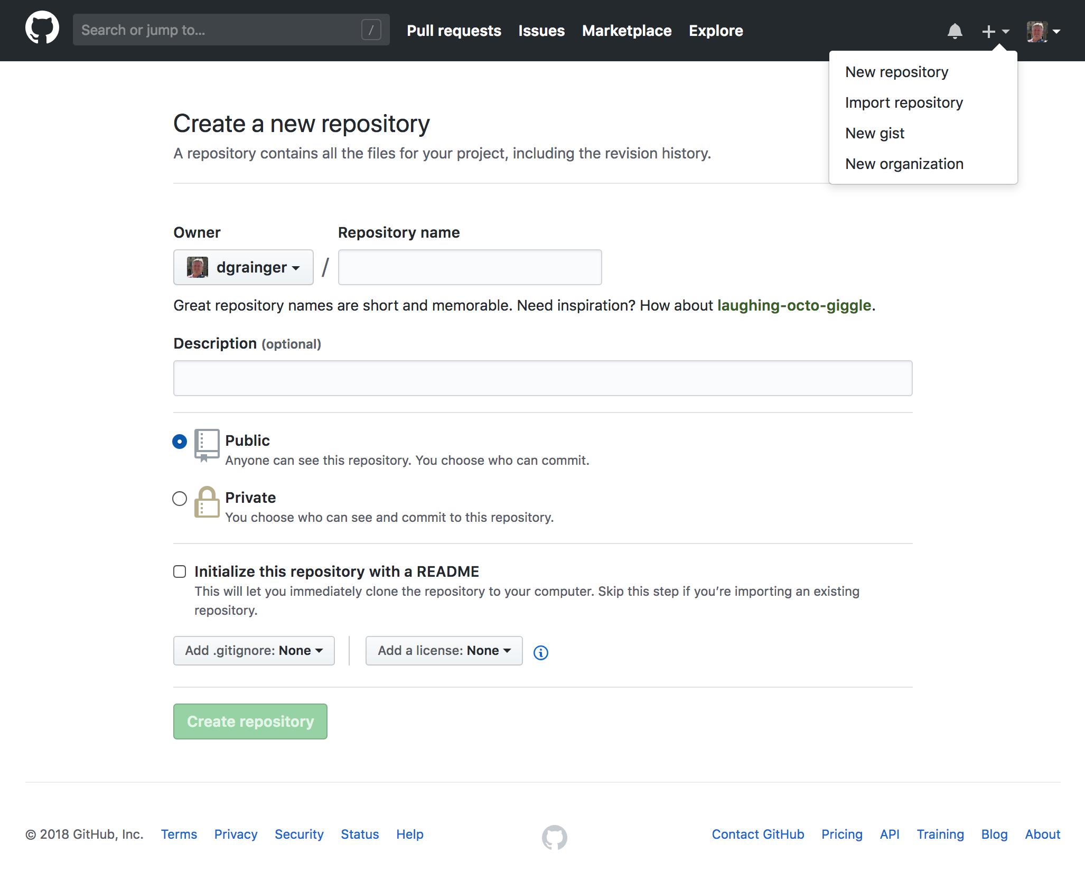
Source control
Notes:
Point out how to open the menu on the + symbol
Give the repository a name
Give a description if you want
Leave it public (private repositories cost money)
You can add a README later
So will skip that
And we’ll add a .gitignore manually as well

Slide 10
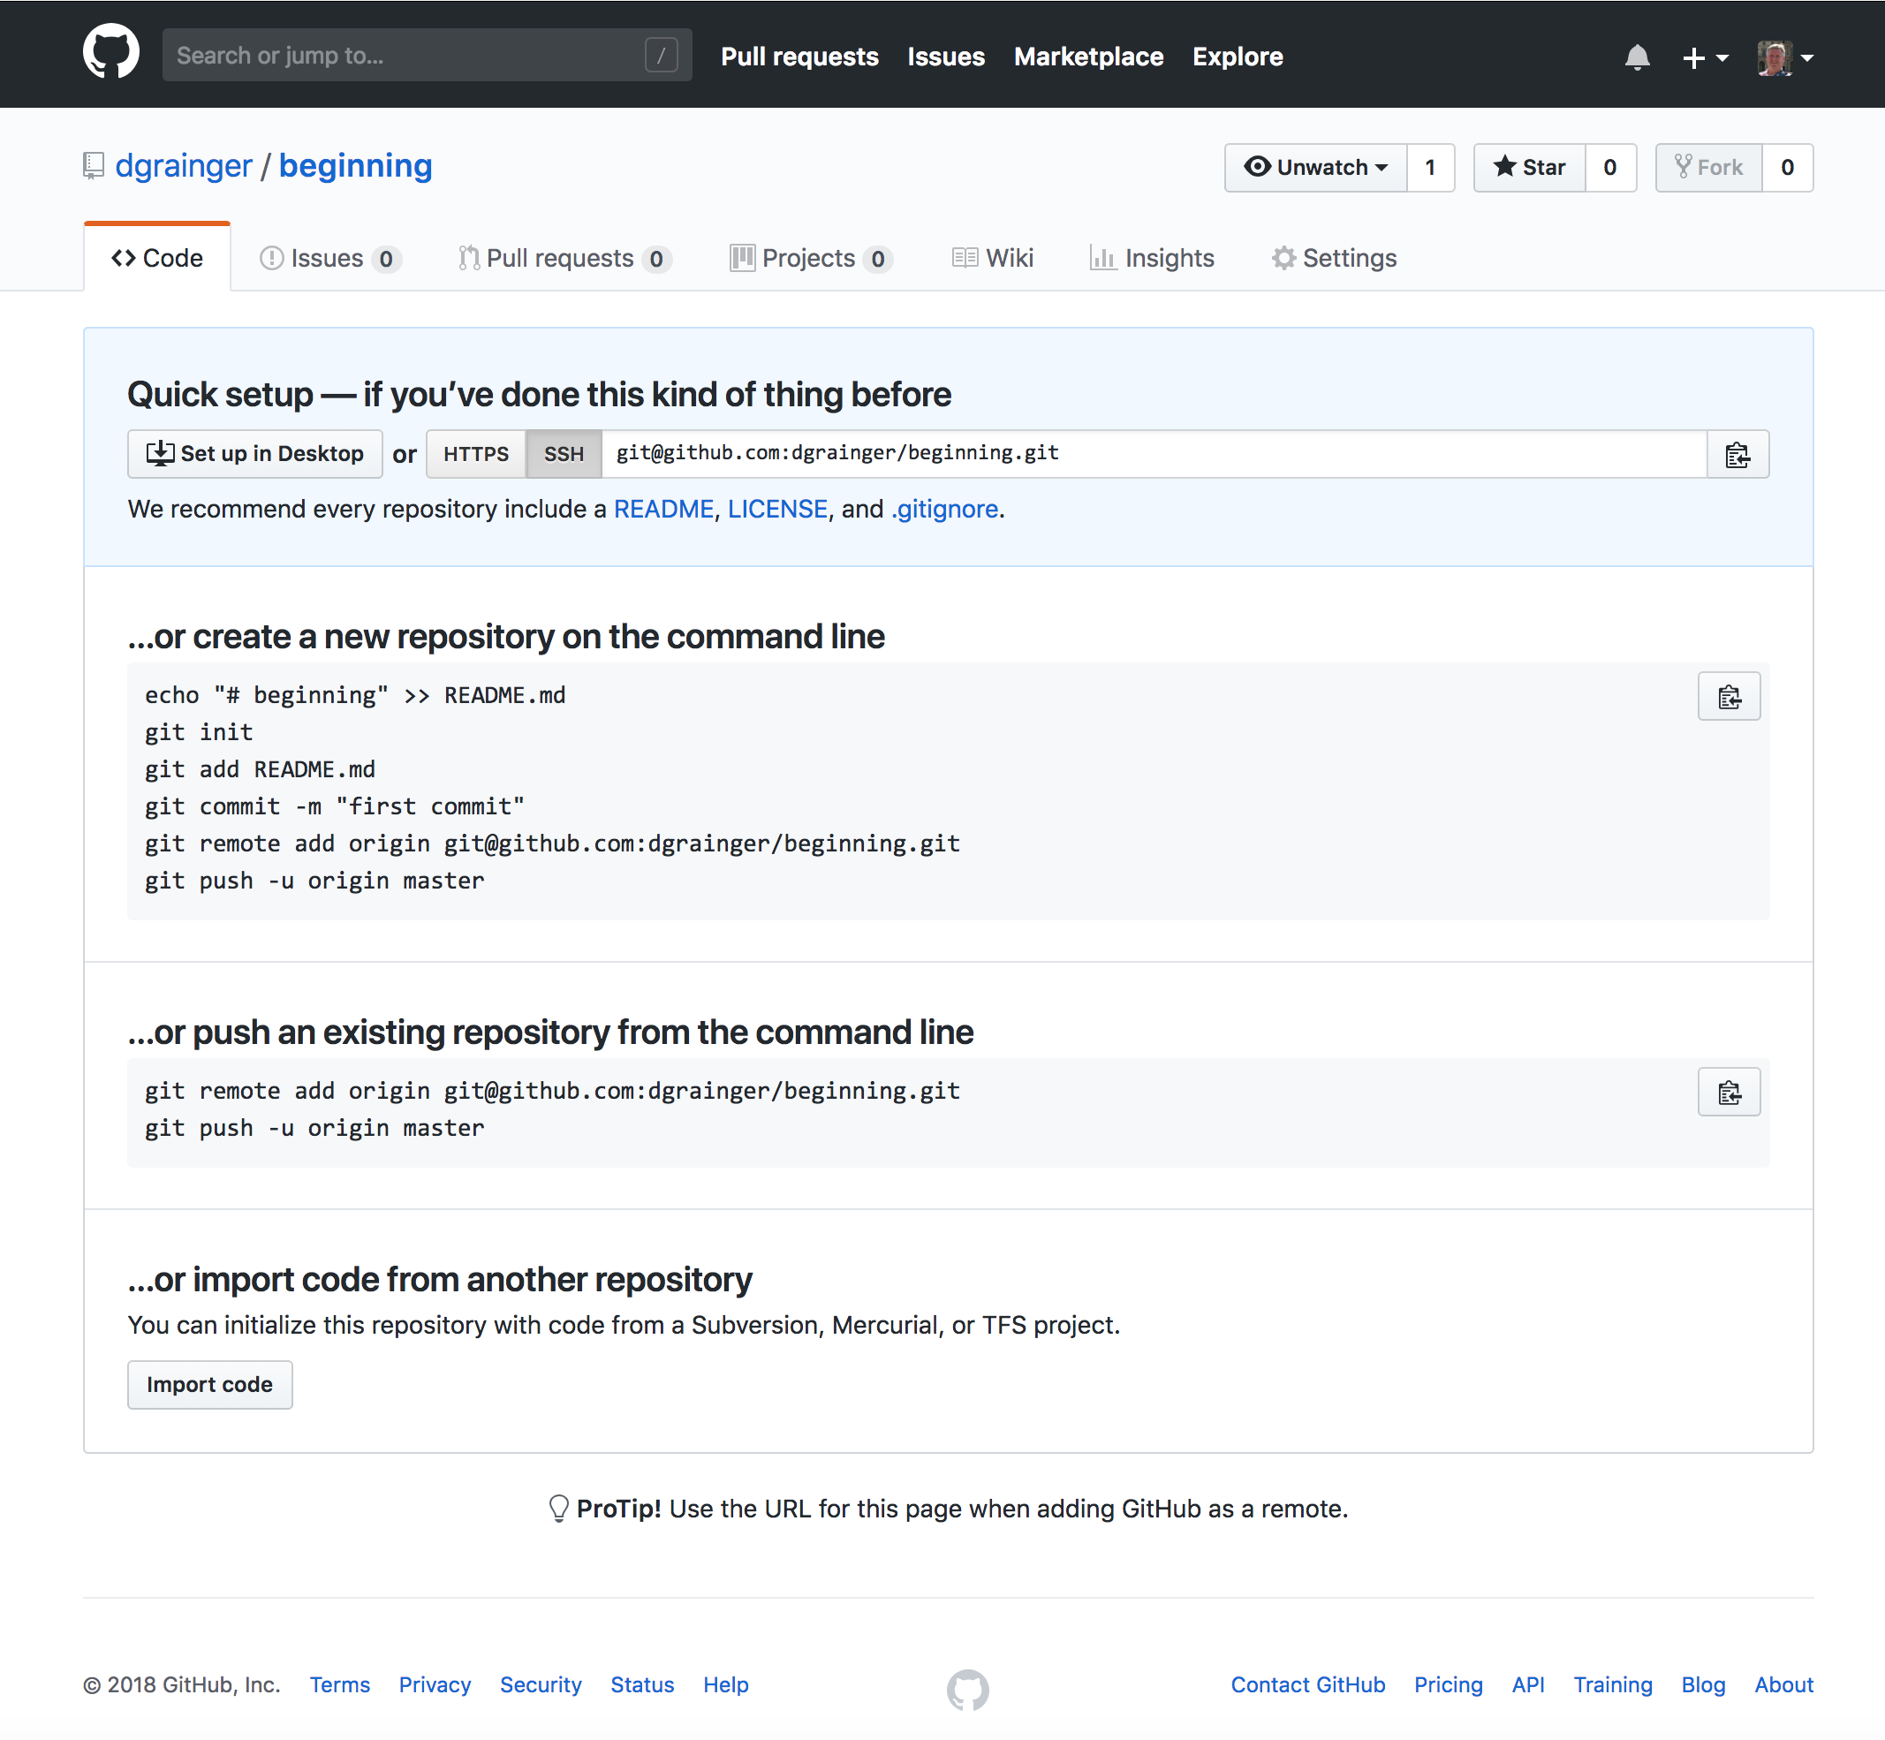
Source control
Notes:
After you create the repository you should see something like this
On the line which says HTTPS and SSH you want to copy the URL into your clipboard

Slide 11
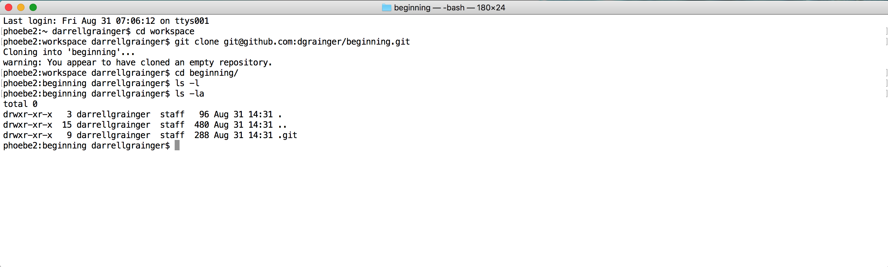
making a local copy to work on
To make a local copy you want to open a shell on your computer
Make a directory to put the work in using mkdir workspace
I made the directory already, so I just change directory using cd workspace
You will mkdir once then cd to it all other times
Then you want to enter git clone followed by a paste from your clipboard
This is assuming the URL from the previous page is still in your clipboard
If you called the repository beginning then cd beginning to switch to it
Once in the repository you can use git commands
Notes:
Talk about how the top window here is my shell and some commands I have typed

Slide 12
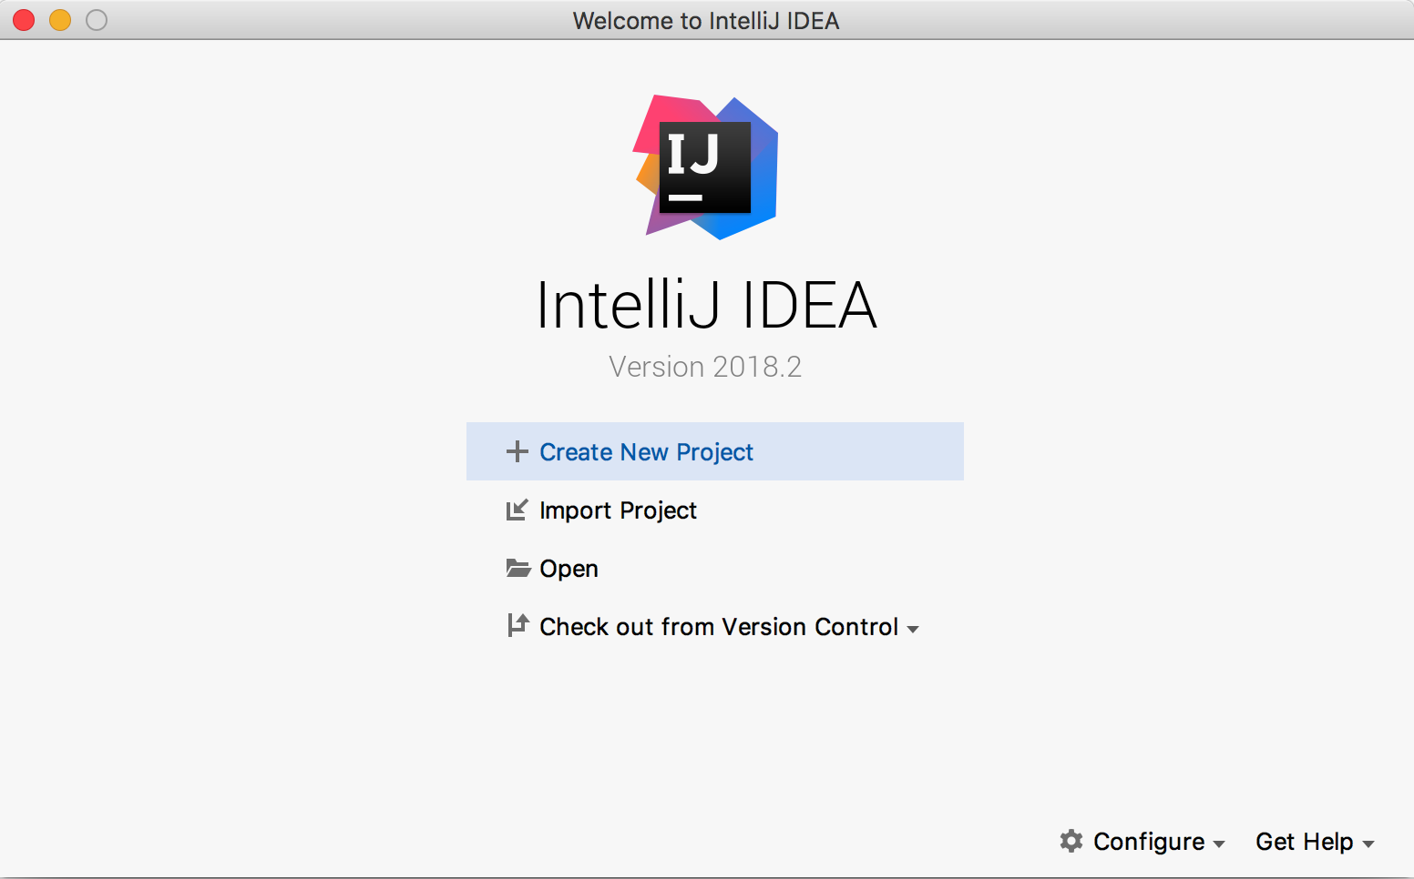
Let’s see what it looks like in the IDE
Notes:
Assuming you downloaded and installed Intellij, this is the startup screen
We want to select Create New Project

Slide 13
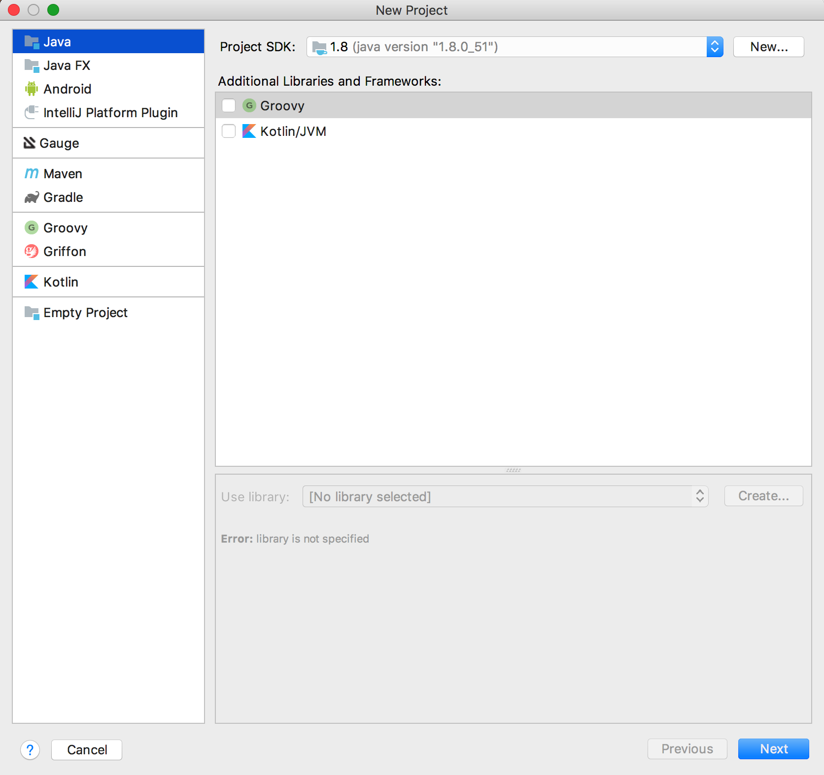
Let’s see what it looks like in the IDE
Notes:
The first page of creating a new project is picking the language
We are going to use Java
Java should already be installed on the machine and added to the Intellij configuration
If it is not, we’ll have to cancel here, install Java and add it to IntelliJ
Then come back to this screen

Slide 14
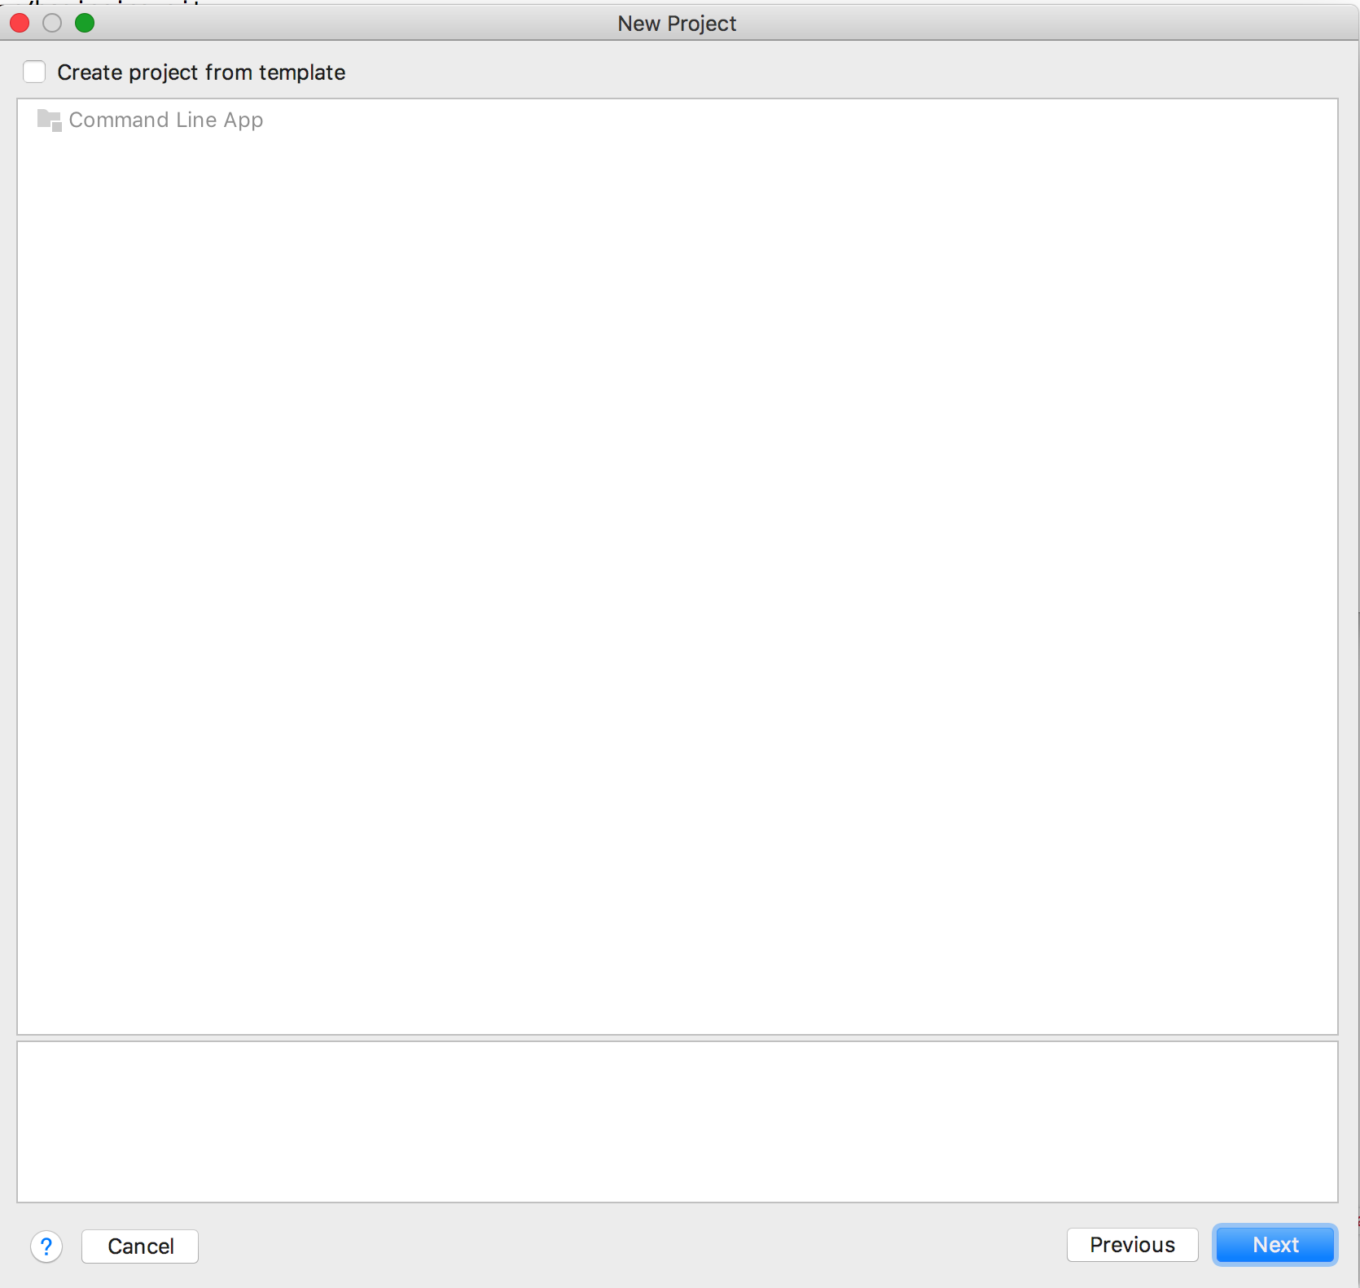
Let’s see what it looks like in the IDE
Notes:
After clicking Next button we come to this screen
Nothing to change here
Click Next button again

Slide 15
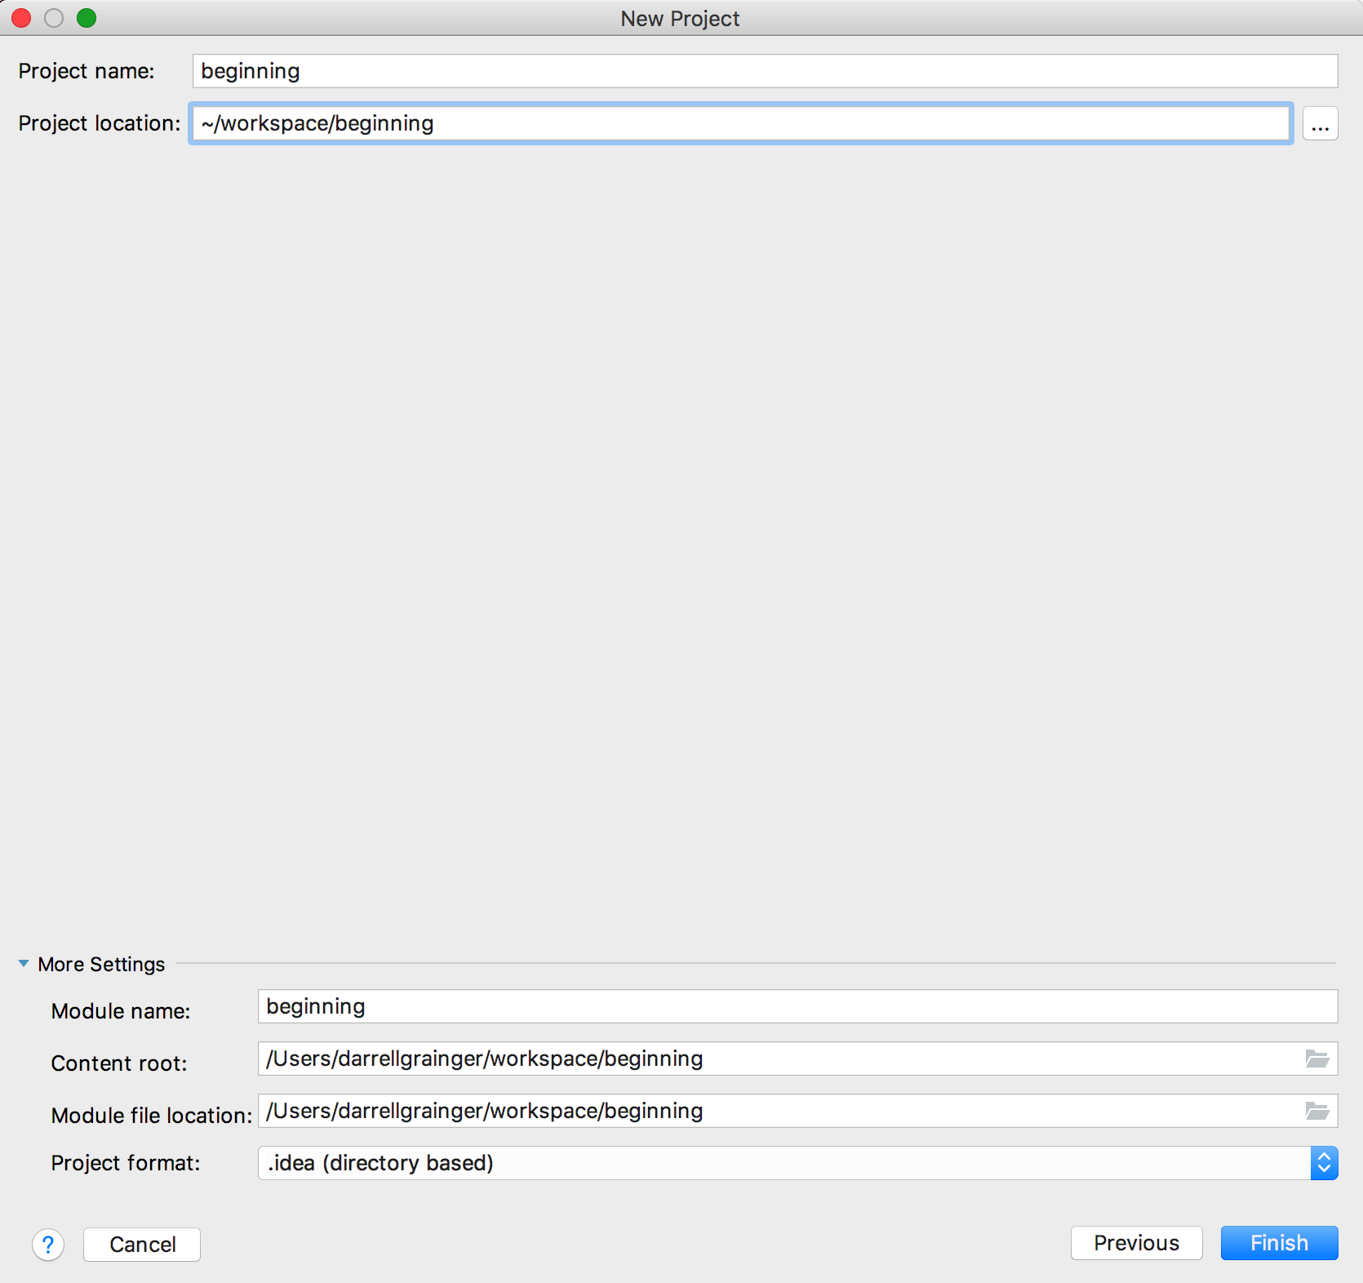
Let’s see what it looks like in the IDE
Notes:
On the final screen we want to edit the location.
You’ll need to know where you cloned the GitHub repository
In my case it was in ~/workspace/beginning
As I type this, it will fill in the Project name, the Module name, etc.
It should look just like mine except the name of the project might be different

Slide 16

Let’s see what it looks like in the IDE
Notes:
After you click Finish button you should see this
On the right is the editor window.
There is nothing there because there is nothing to edit, yet
On the left is the project.
You will notice the beginning.iml file in red
This is the file Intellij created for the new project
It is not being backed up by git, so it is red
Around the edges of the window are tools
Like Terminal down at the bottom

Slide 17
Adding selenium libraries and binaries
What if I want to add a library, like Selenium
First, I need a directory to put all the library files in
The next picture shows how to do this
Notes:
After you click Finish button you should see this
On the right is the editor window.
There is nothing there because there is nothing to edit, yet
On the left is the project.
You will notice the beginning.iml file in red
This is the file Intellij created for the new project
It is not being backed up by git, so it is red
Around the edges of the window are tools
Like Terminal down at the bottom

Slide 18
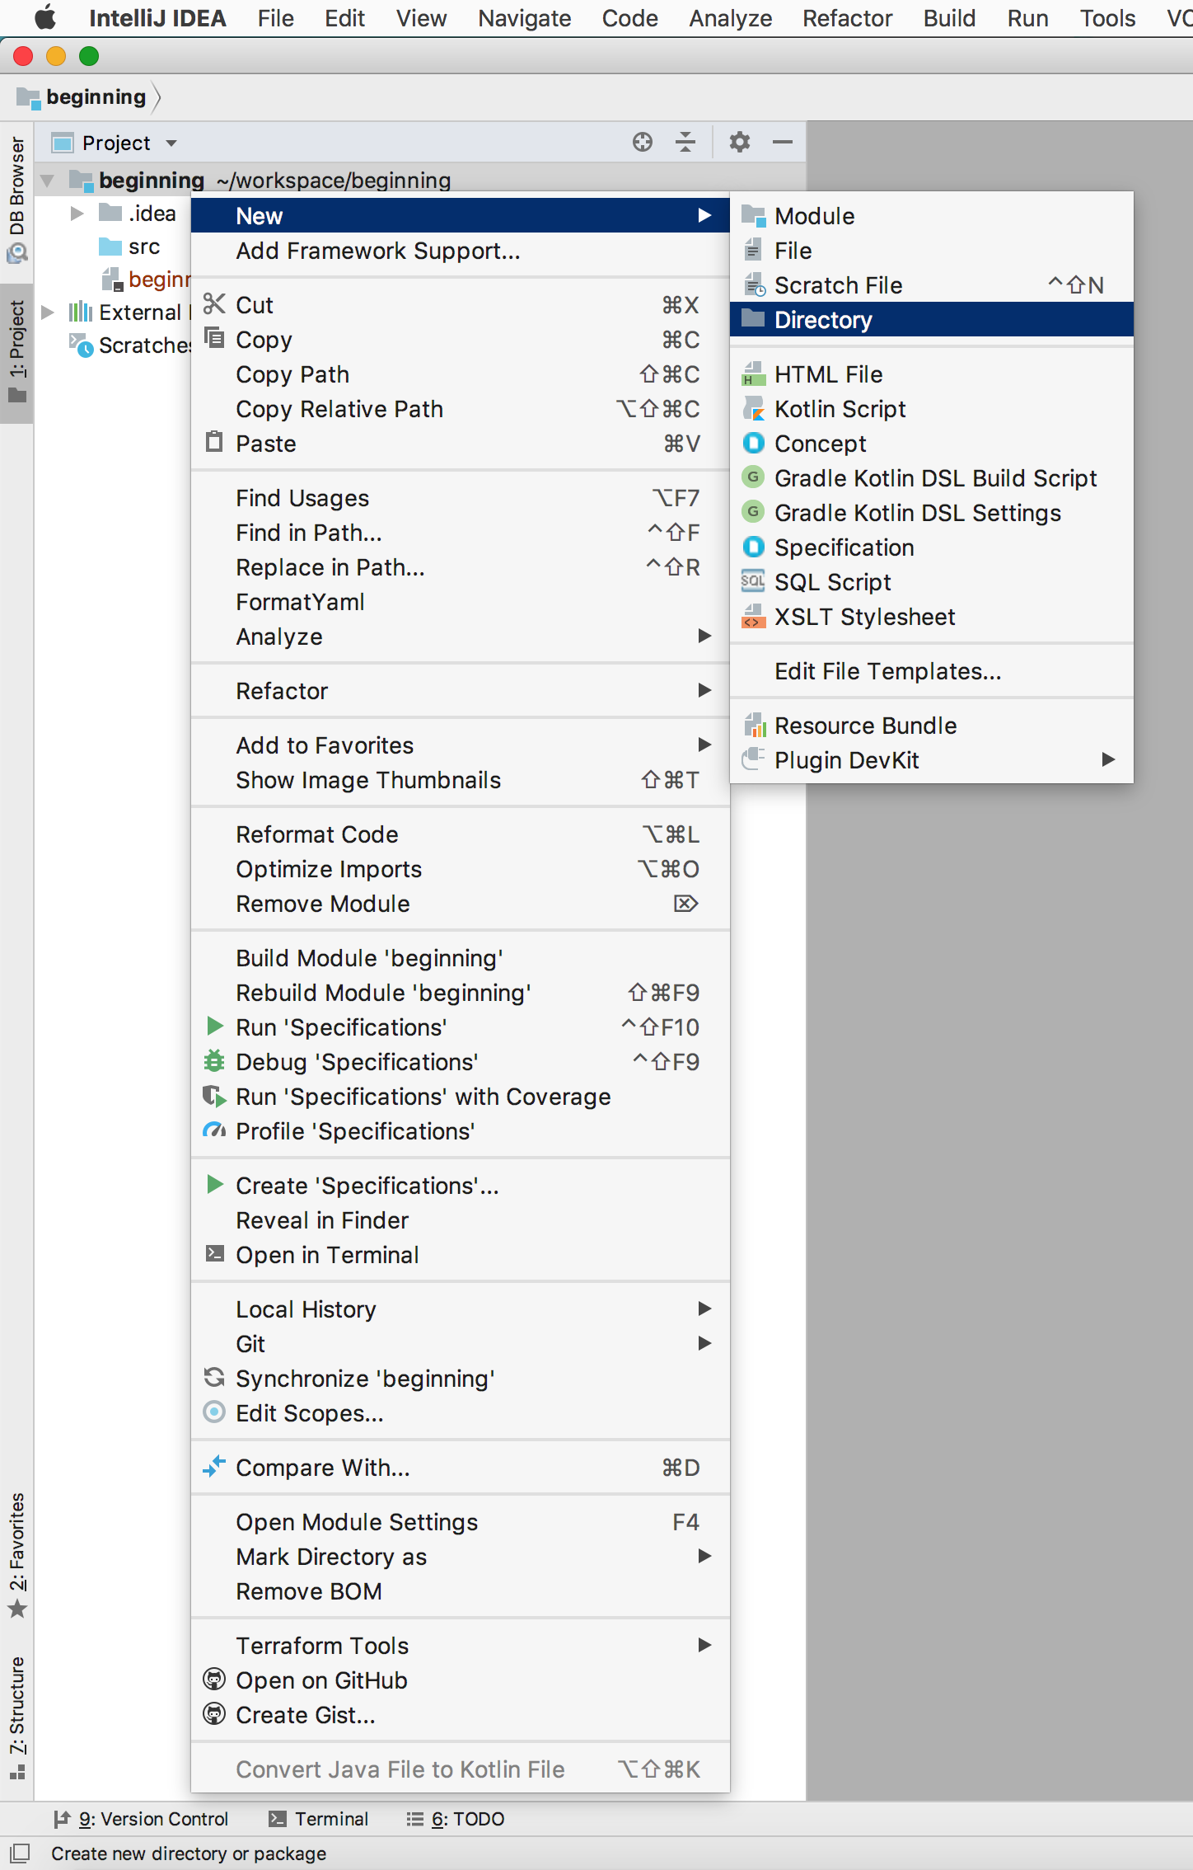
Let’s see what it looks like in the IDE
Notes:
A lot of the features of a good IDE are available as a right click
Different menus will appear depending on where you right click
I want to add a directory to the project
So I right click on the project name (beginning) and a menu appears
Select New->Directory and add a directory
I’m going to call the directory libs
There is a reason for this but really I could have called it anything

Slide 19
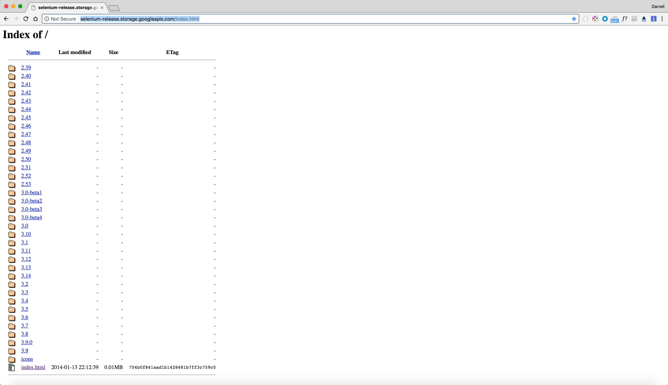
Now I need files to put in the new directory
Notes:
If you go to the URL noted in the picture, you will find all the Selenium libraries
Let’s get the latest set of libraries
This is the 3.9 directory

Slide 20
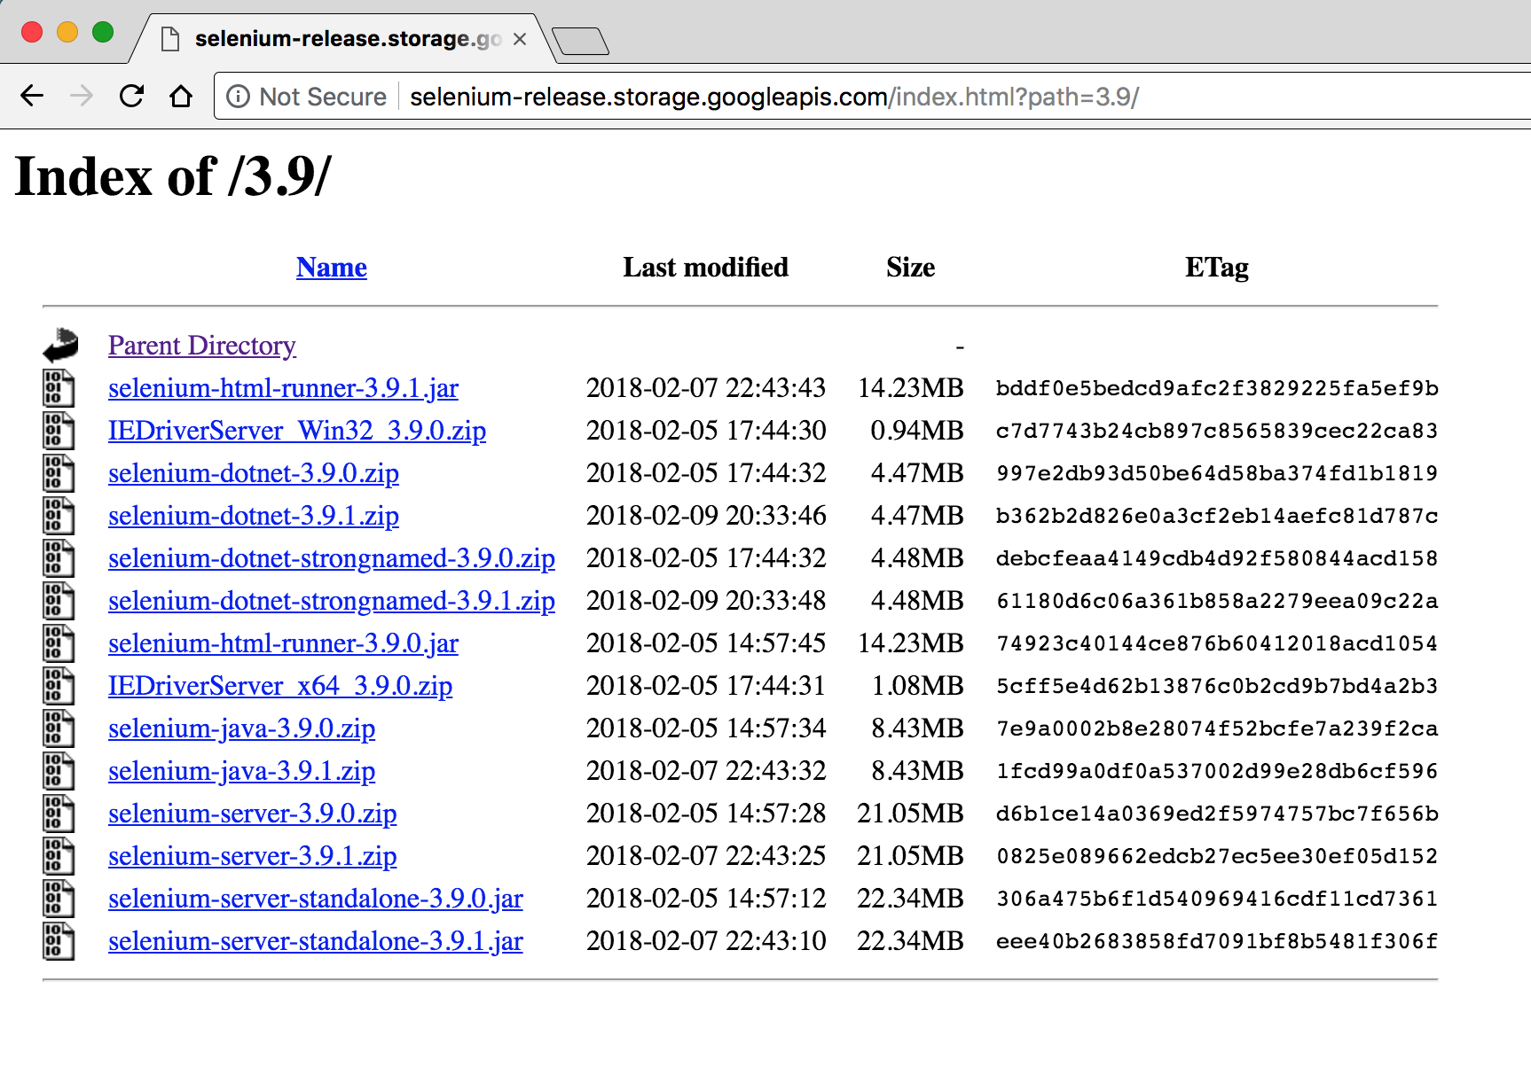
Now I need files to put in the new directory
Notes:
When I click on 3.9 I see the following.
Having read up on Selenium, how it works, etc.
I know what all these files mean
For now just now that you only need some of them
Others are for C# or Internet Explorer
We’ll need:
selenium-java-3.9.1.zip
selenium-server-standalone-3.9.1.jar
Download the server jar file into the libs directory your created
Download the zip file anywhere but you need to unzip it into the libs folder
You can either download the zip file, unzip it and copy all the files to the libs folder
Or you can use the command line and unzip to unzip the files

Slide 21
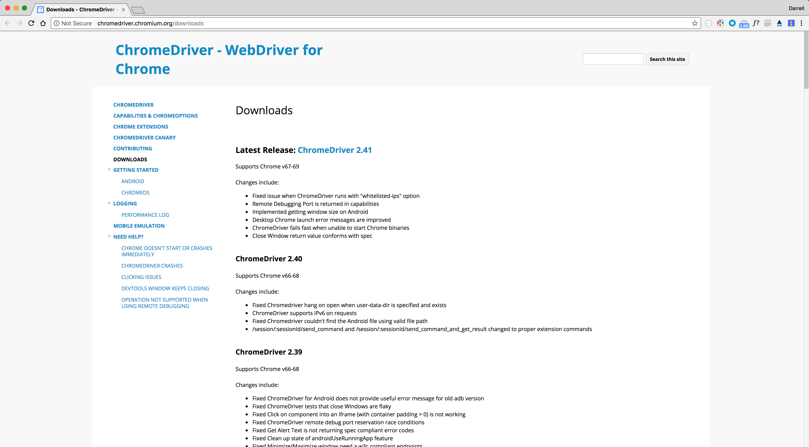
Now I need files to put in the new directory
Notes:
Selenium also requires a binary to allow the Selenium client to talk to the browser
We are going to use Chrome to start
So we need to download the chromedriver
Go to the URL in the picture
If you click the “ChromeDriver 2.41” it will take you to the downloads for that version

Slide 22
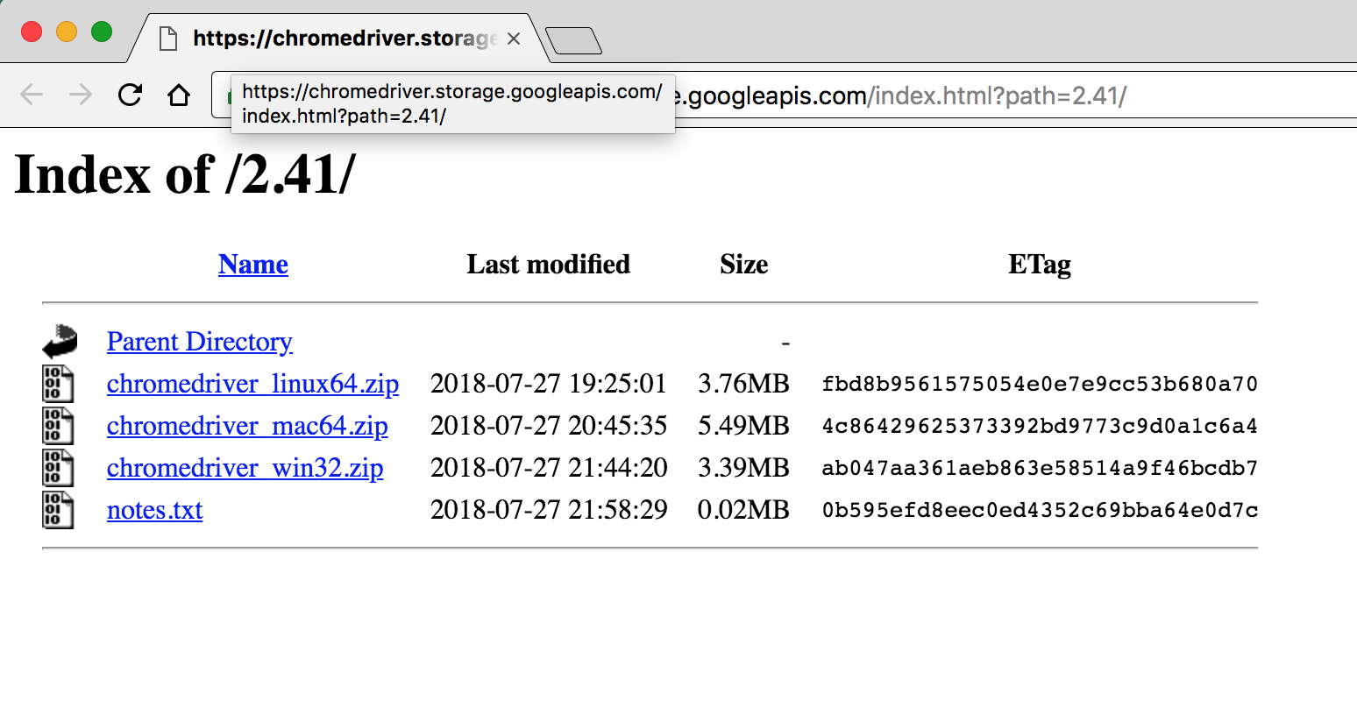
Now I need files to put in the new directory
Notes:
There are different versions of chromedriver depending on your operating system
I am using a macOS computer, so I download the chromedriver_mac64.zip file
I then want to unzip this file into the root of my project (not the libs folder)

Slide 23
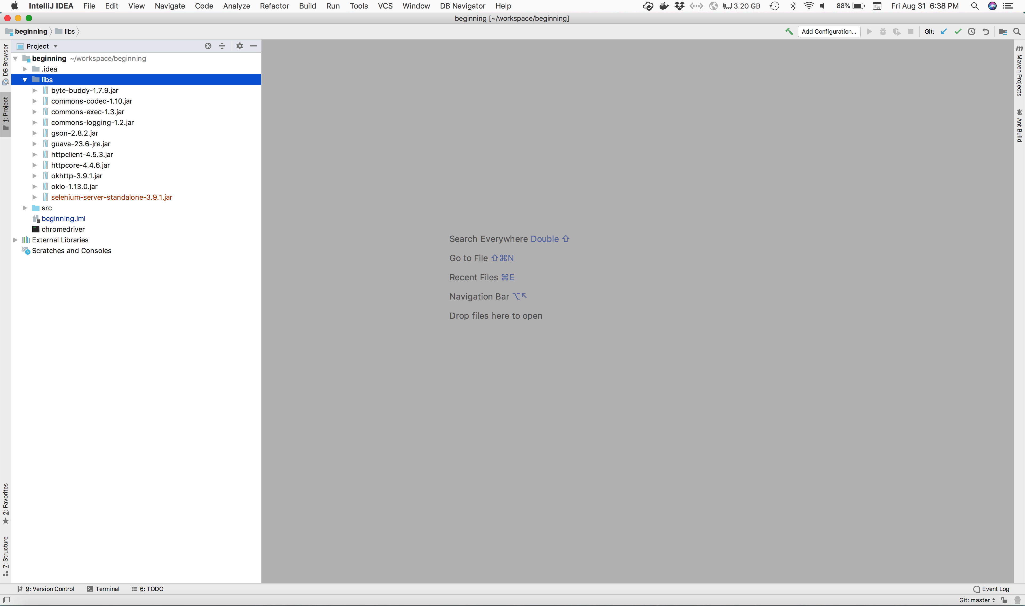
when everything is setup
Notes:
Once everything is installed it should look like this:
There is a libs folder
In the libs folder are the Selenum libraries (jar files)
In the root of the project is the chromedriver binary

Slide 24
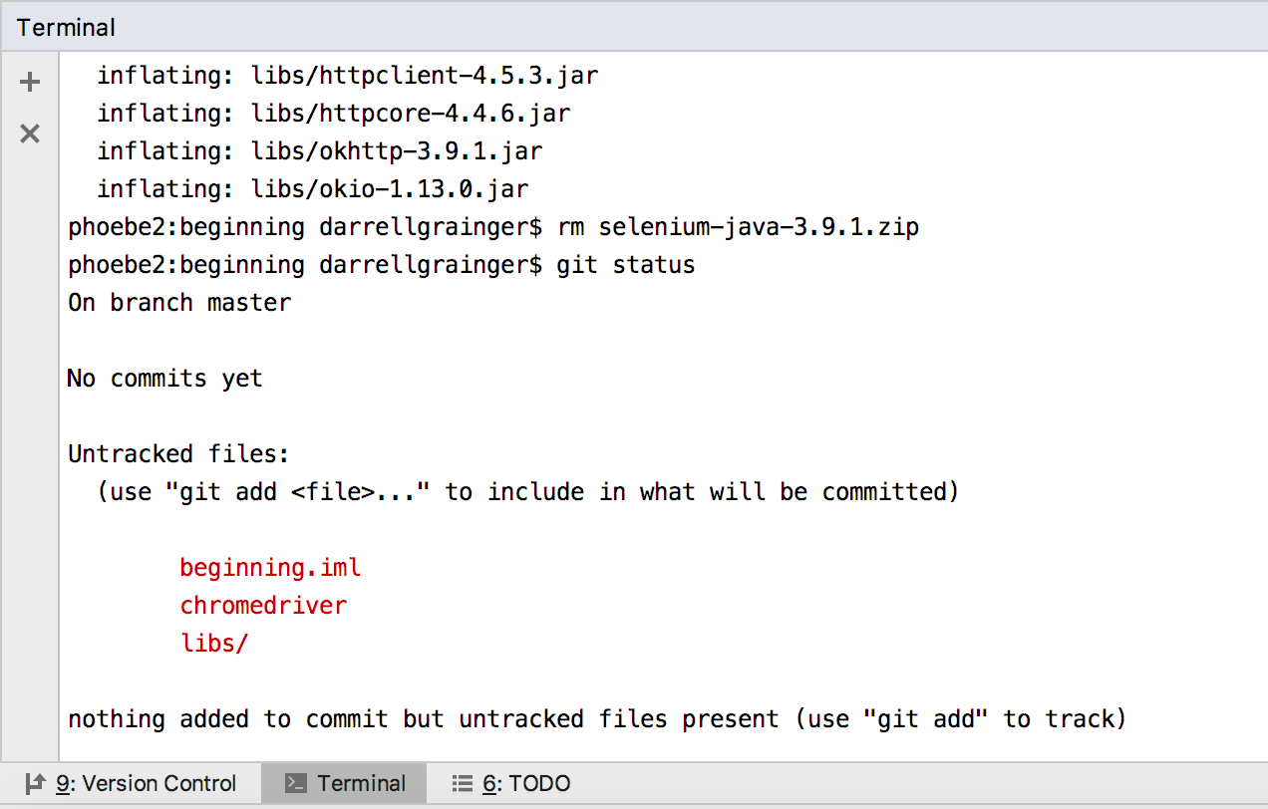
adding the new files to git
Notes:
If we open the Terminal at the bottom of the IDE we can type shell commands here
To unzip the files the command is: (write this somewhere)
cd ~/workspace/beginning
unzip ~/Downloads/selenium-java-3.9.1.zip 'libs/*’
Next I can enter git status to see what is happening with my local git repository
I can see that there are changes to the project file, the chromedriver is new and the libs/ directory is new

Slide 25
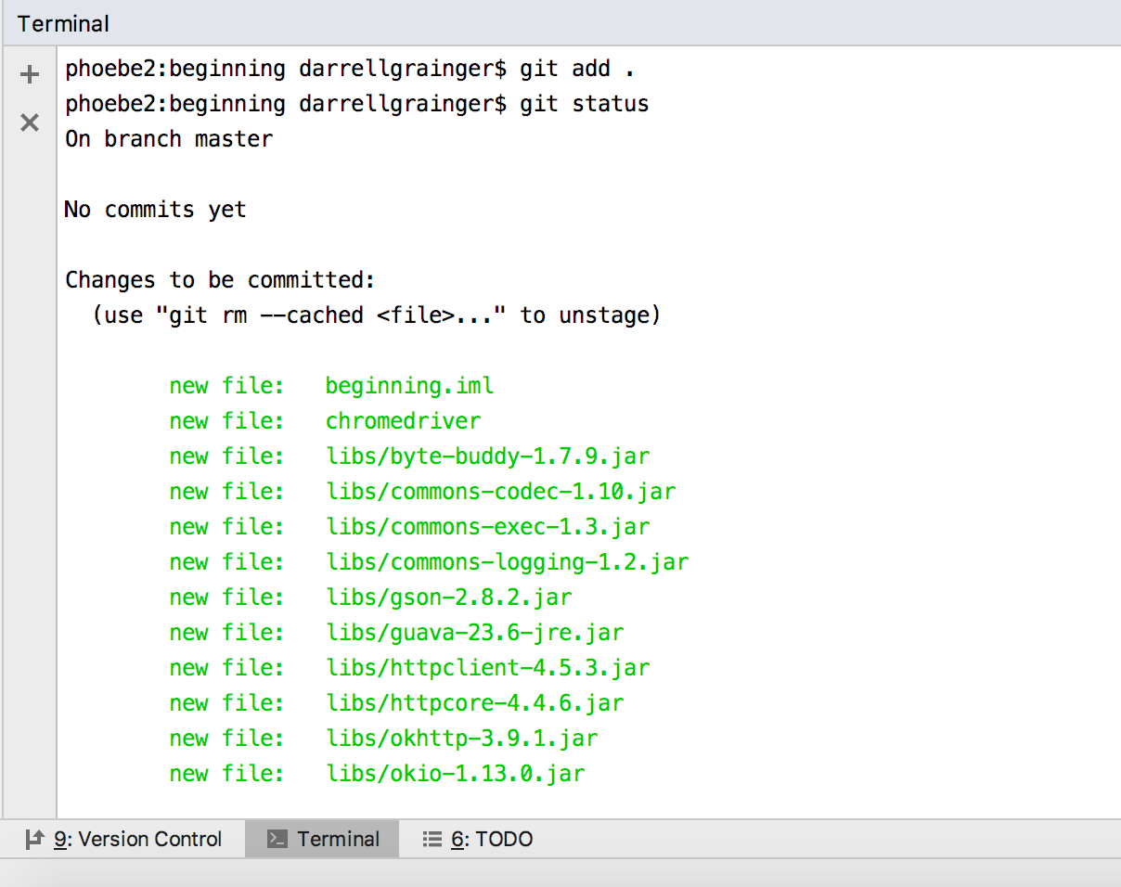
adding the new files to git
Notes:
If I type git add . it will stage all the untracked files to be added
This doesn’t actually add any of the files to the repository
I can now see all the files which are going to be added to the repository, if I use git commit

Slide 26
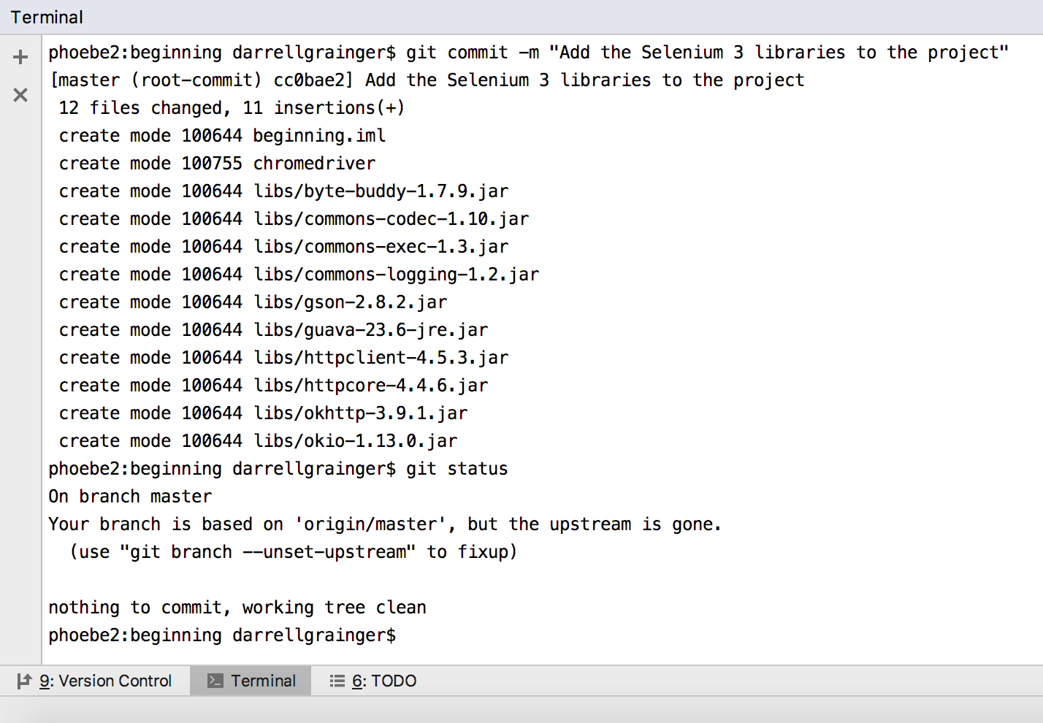
adding the new files to git
Notes:
Now I issue a git commit command
This actually adds all the files to a local repository
This is a repository only on my machine
The files have not be copied to GitHub

Slide 27
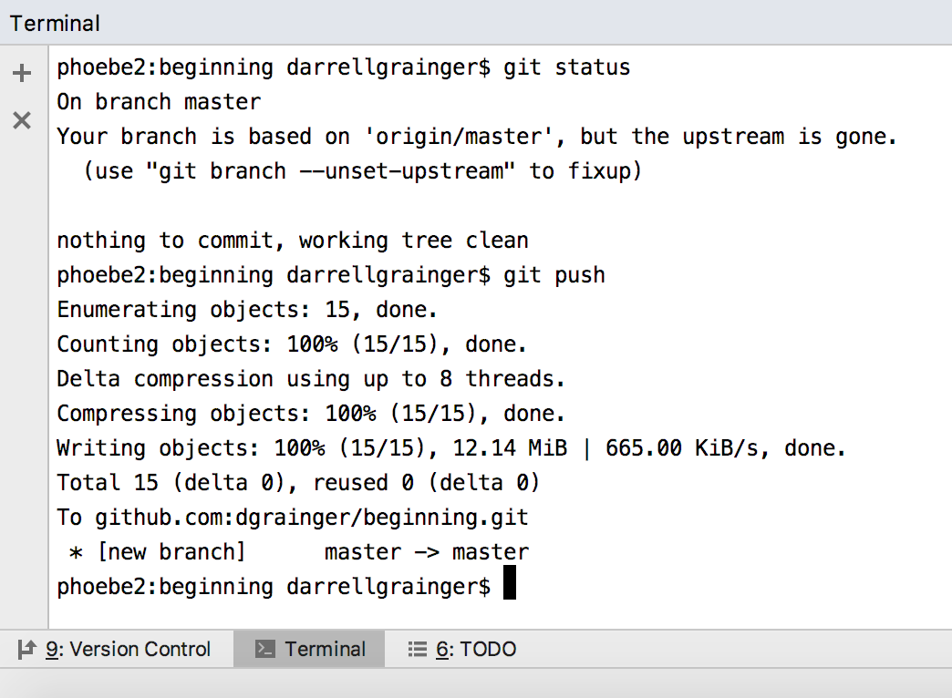
adding the new files to git
Notes:
To copy the files from my local machine to GitHub I issue git push
There are parameters I can use with push but if I use all the defaults, git will figure things out

Slide 28
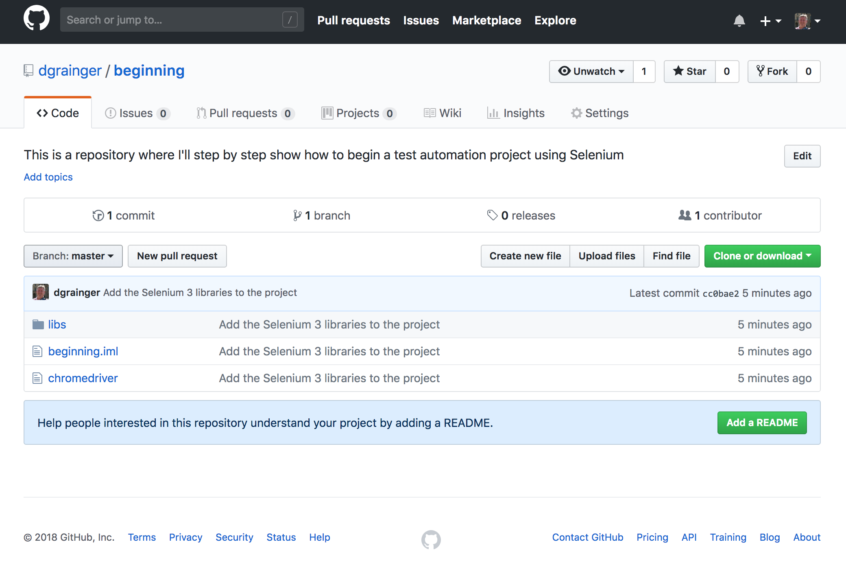
adding the new files to git
Notes:
If I go to my empty repository on https://www.github.com I: see the following
All the changes I made locally are now copied to GitHub as well
Now I have two backups as well as the original on my machine

Slide 29
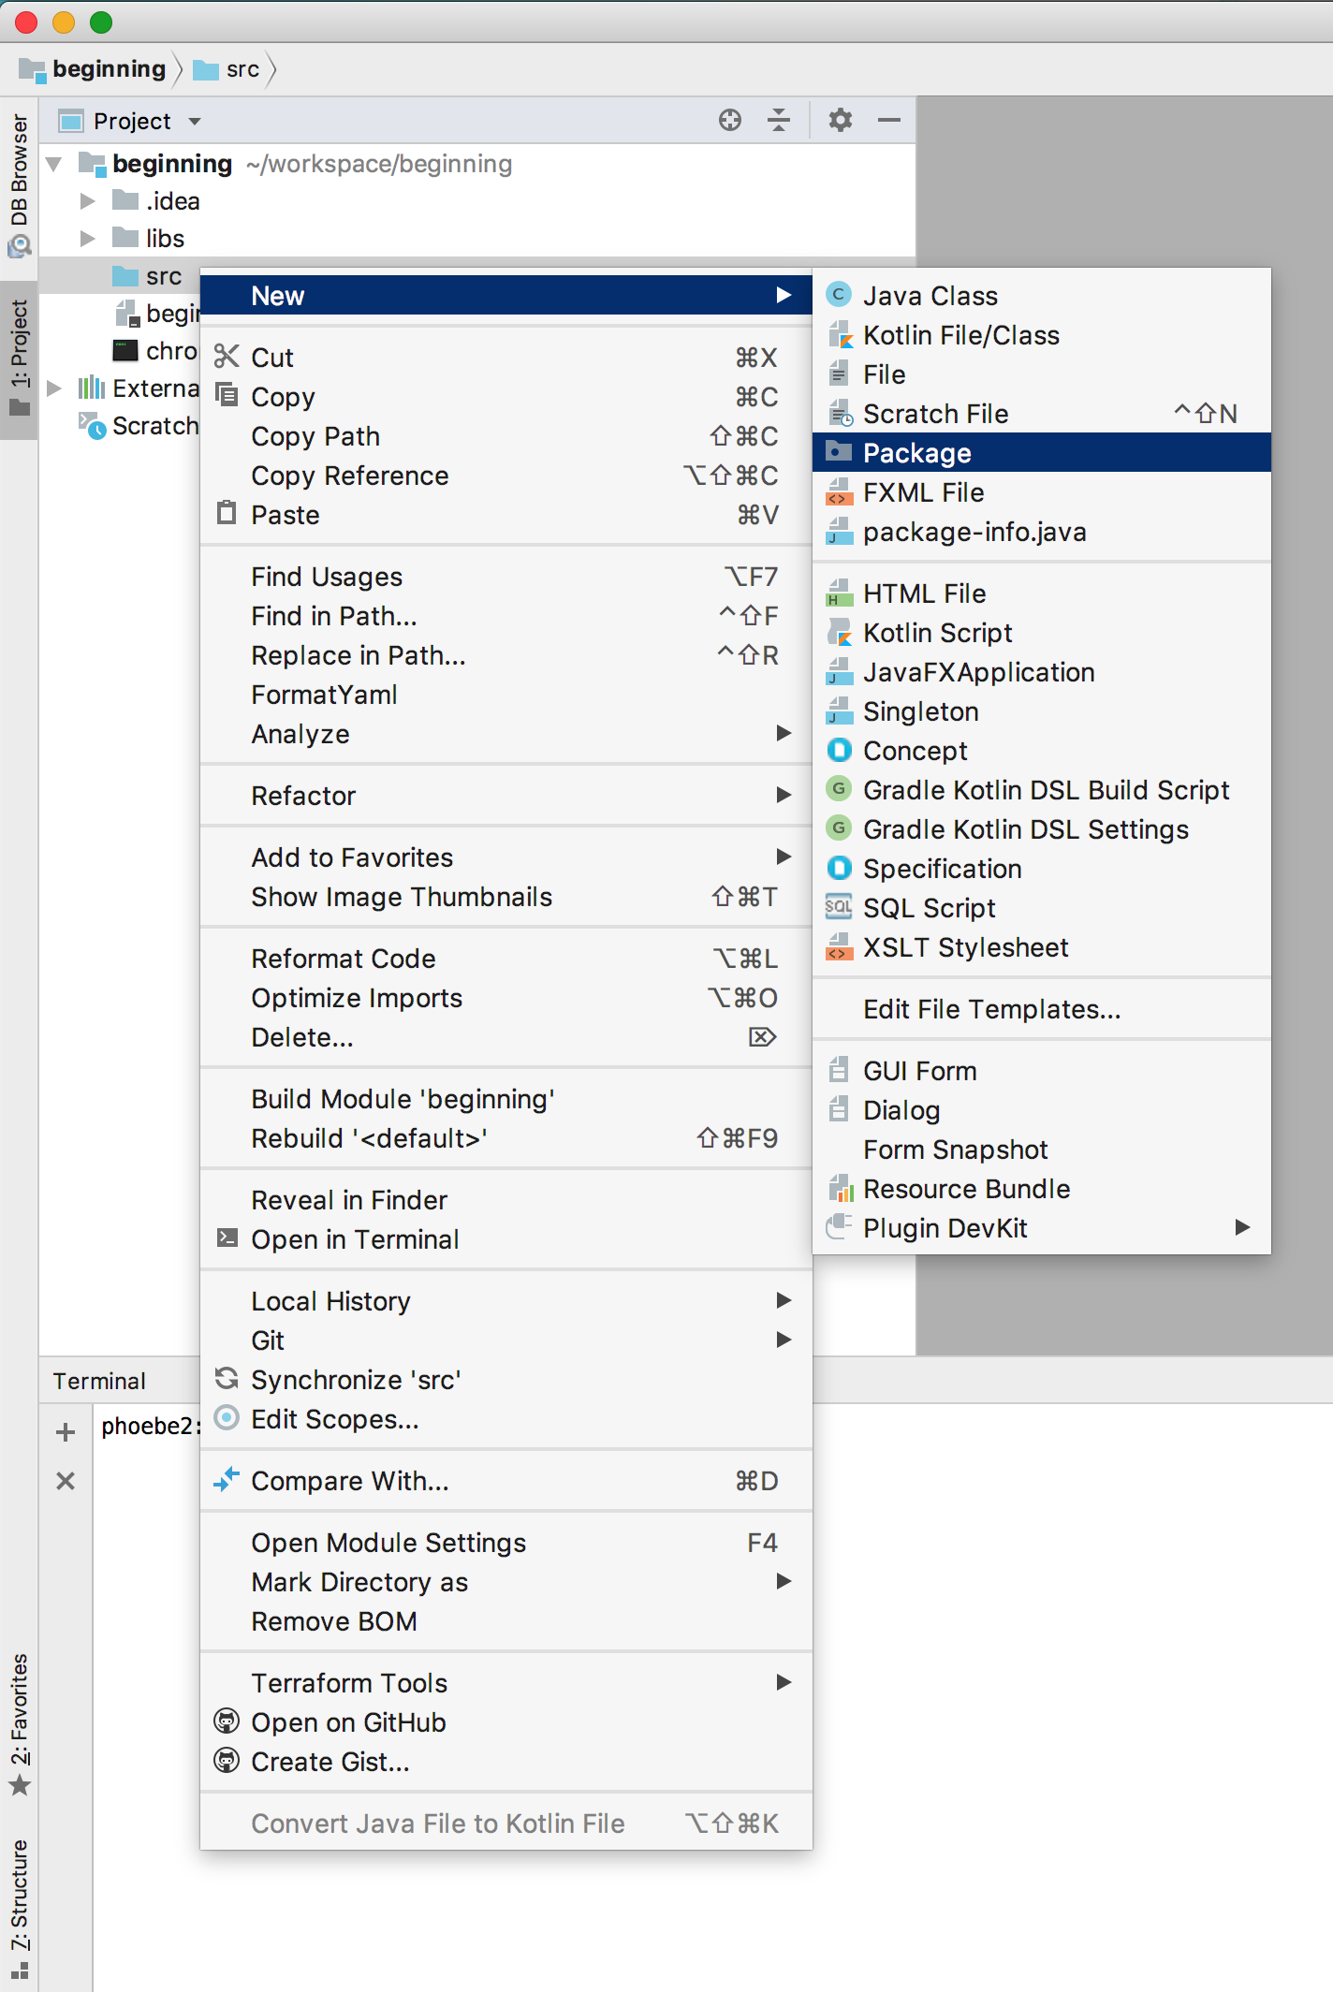
Java conventions
Notes:
Let’s create our first test automation.
First, a Java convention is to organize classes by package
For example, if I want the file ~/workspace/beginning/com/darrell/Example1.java
then I want the package “com.darrell” and the class “Example1”
So this picture shows how to create a package

Slide 30
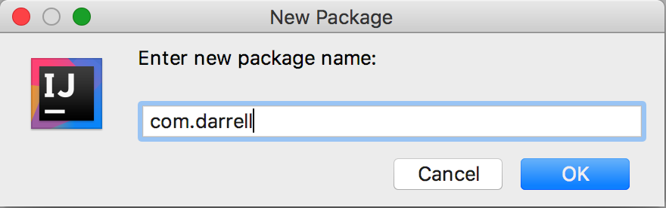
Java conventions
Notes:
If you look at the Selenium lirbaries they are often in org.openqa or com.thoughtworks
I like to use something with my name in it
So com.darrell, org.darrell, com.dgrainger, etc.
This is just a convention and won’t actually make any difference for running the test code

Slide 31
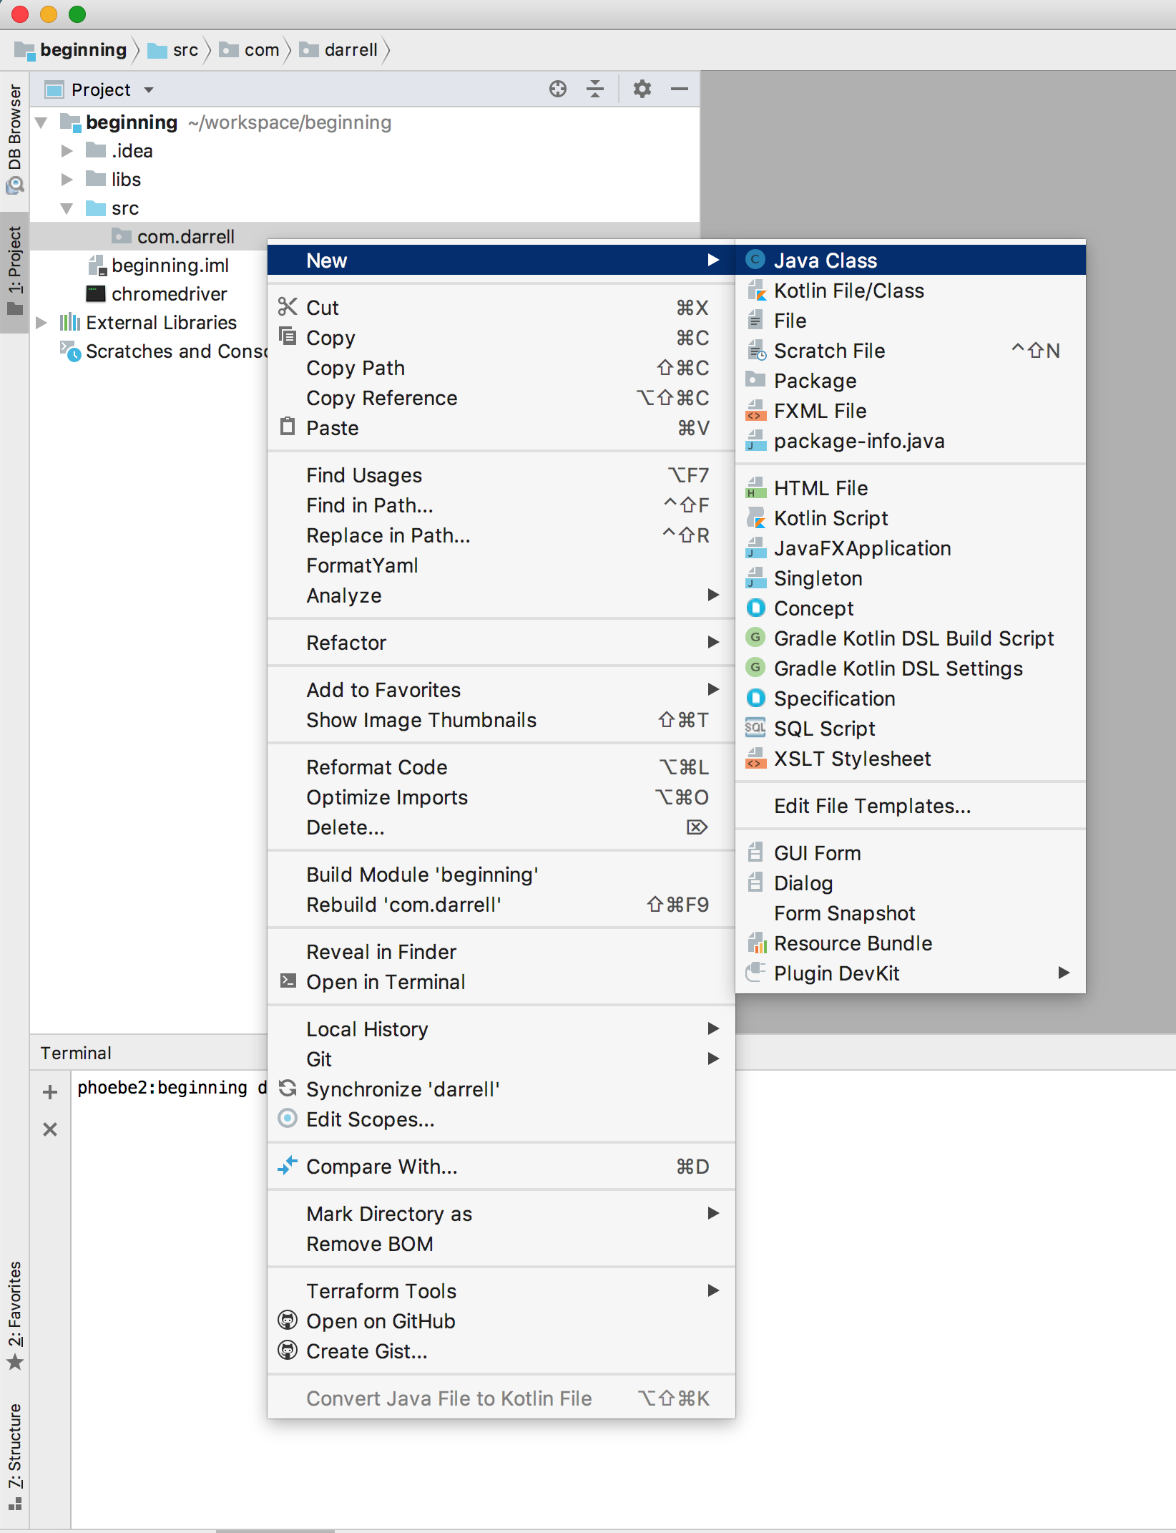
Java conventions
Notes:
Next I want to create a class to hold my automation code
So I right click on the package name
then select New->Java Class

Slide 32
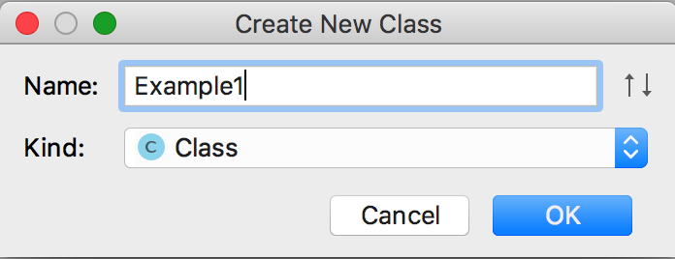
Java conventions
Notes:
I’m going to give my class the name Example1
If I was creating automation for say Google I might use the package com.google
and the class might be BasicSearch for testing basic search features

Slide 33
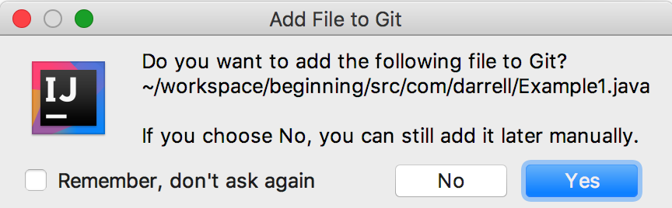
Intellij helps
Notes:
After you create the class Intellij will ask you if you want to add Example1.java to Git
This is an example of how Intellij helps you.
I selected Yes so I didn’t have to do this later
You could also click Remember, don’t ask again but there might be some files you don’t want added to Git

Slide 34
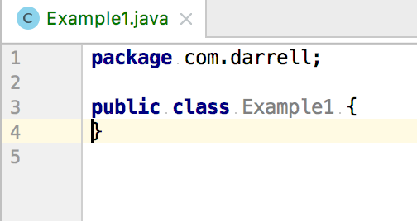
intellij helps
If we look at the file Example1.java we see the above text
Intellij filled in things like the package and class information
We don’t want to change any of this
We just want to add to it

Slide 35
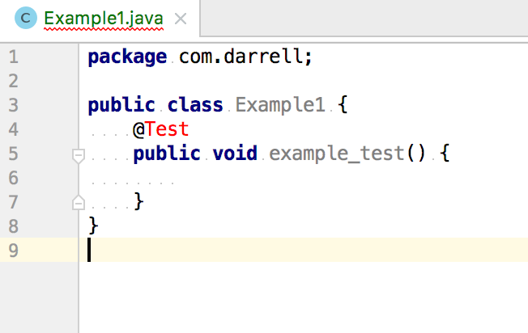
more intellij help
I want to use the Junit test framework
I know it has things like @Test so I type that
This is called an annotation because it starts with an @ symbol
But Intellij shows this as red
I can move the cursor to the work @Test
Then press alt-enter

Slide 36
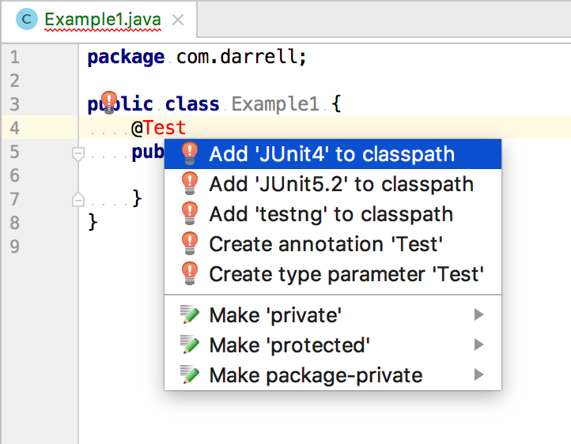
Intellij makes fix suggestions
A context menu will pop up and suggest how to fix the error
I want to use JUnit 4, so I take the first suggestion
When Java is compiling the code, it will search the classpath for all the libraries
By adding JUnit 4 to the classpath it helps the Java compiler

Slide 37
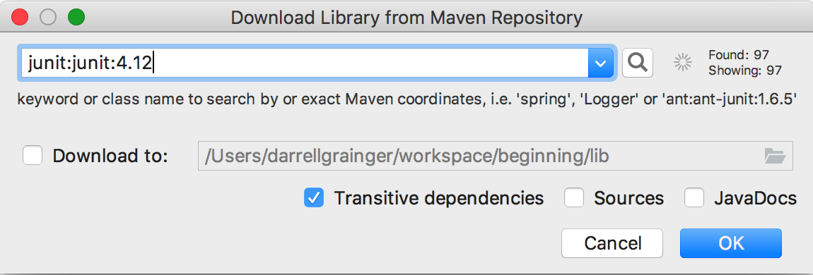
Intellij knows to download libraries for us
When you tell Intellij to add Junit to the classpath, it is smart enough to realize you need the actual library too
So it asks you to download it
You can download it to the standard, global location
Or we can click the Download to: option and download it to our libs directory (not the lib directory Intellij suggests)

Slide 38
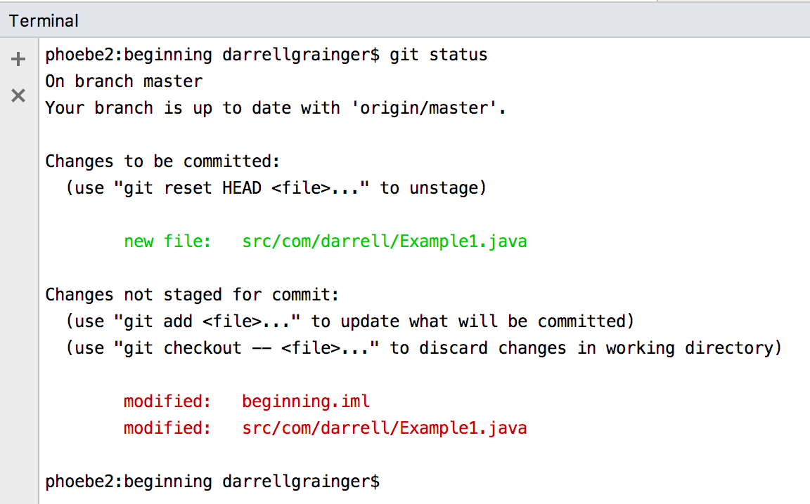
git status
Notes:
Let’s go to the Terminal and check the git status
Here we see that git recognizes we changed the Example1.java file
And we made changes to the project (classpath, added junit library)

Slide 39
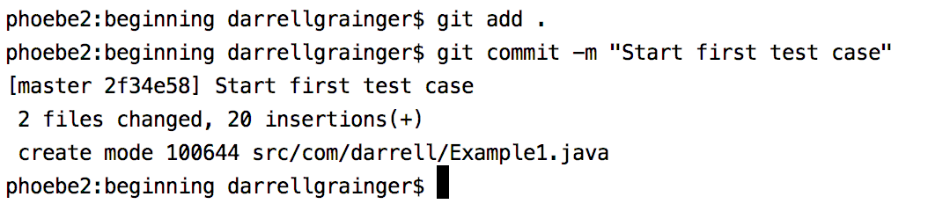
commit the changes to git
Again, we want to stage the changes to be commited
So we git add . to add all the changes
It should be noted that sometimes we might only commit specific changes
I’ll talk about that shortly
Then we want to commit the changes locally
Notice the -m option
We usually want to give a message about what we are commiting

Slide 40
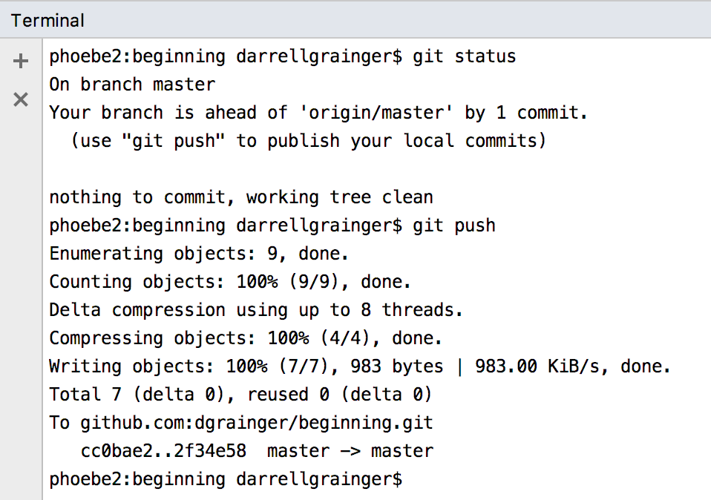
push the changes to github
Finally, we want to push the changes to GitHub
Notice that git status tells us our local copy is ahead of GitHub
So there is nothing to commit but there is something to push

Slide 41
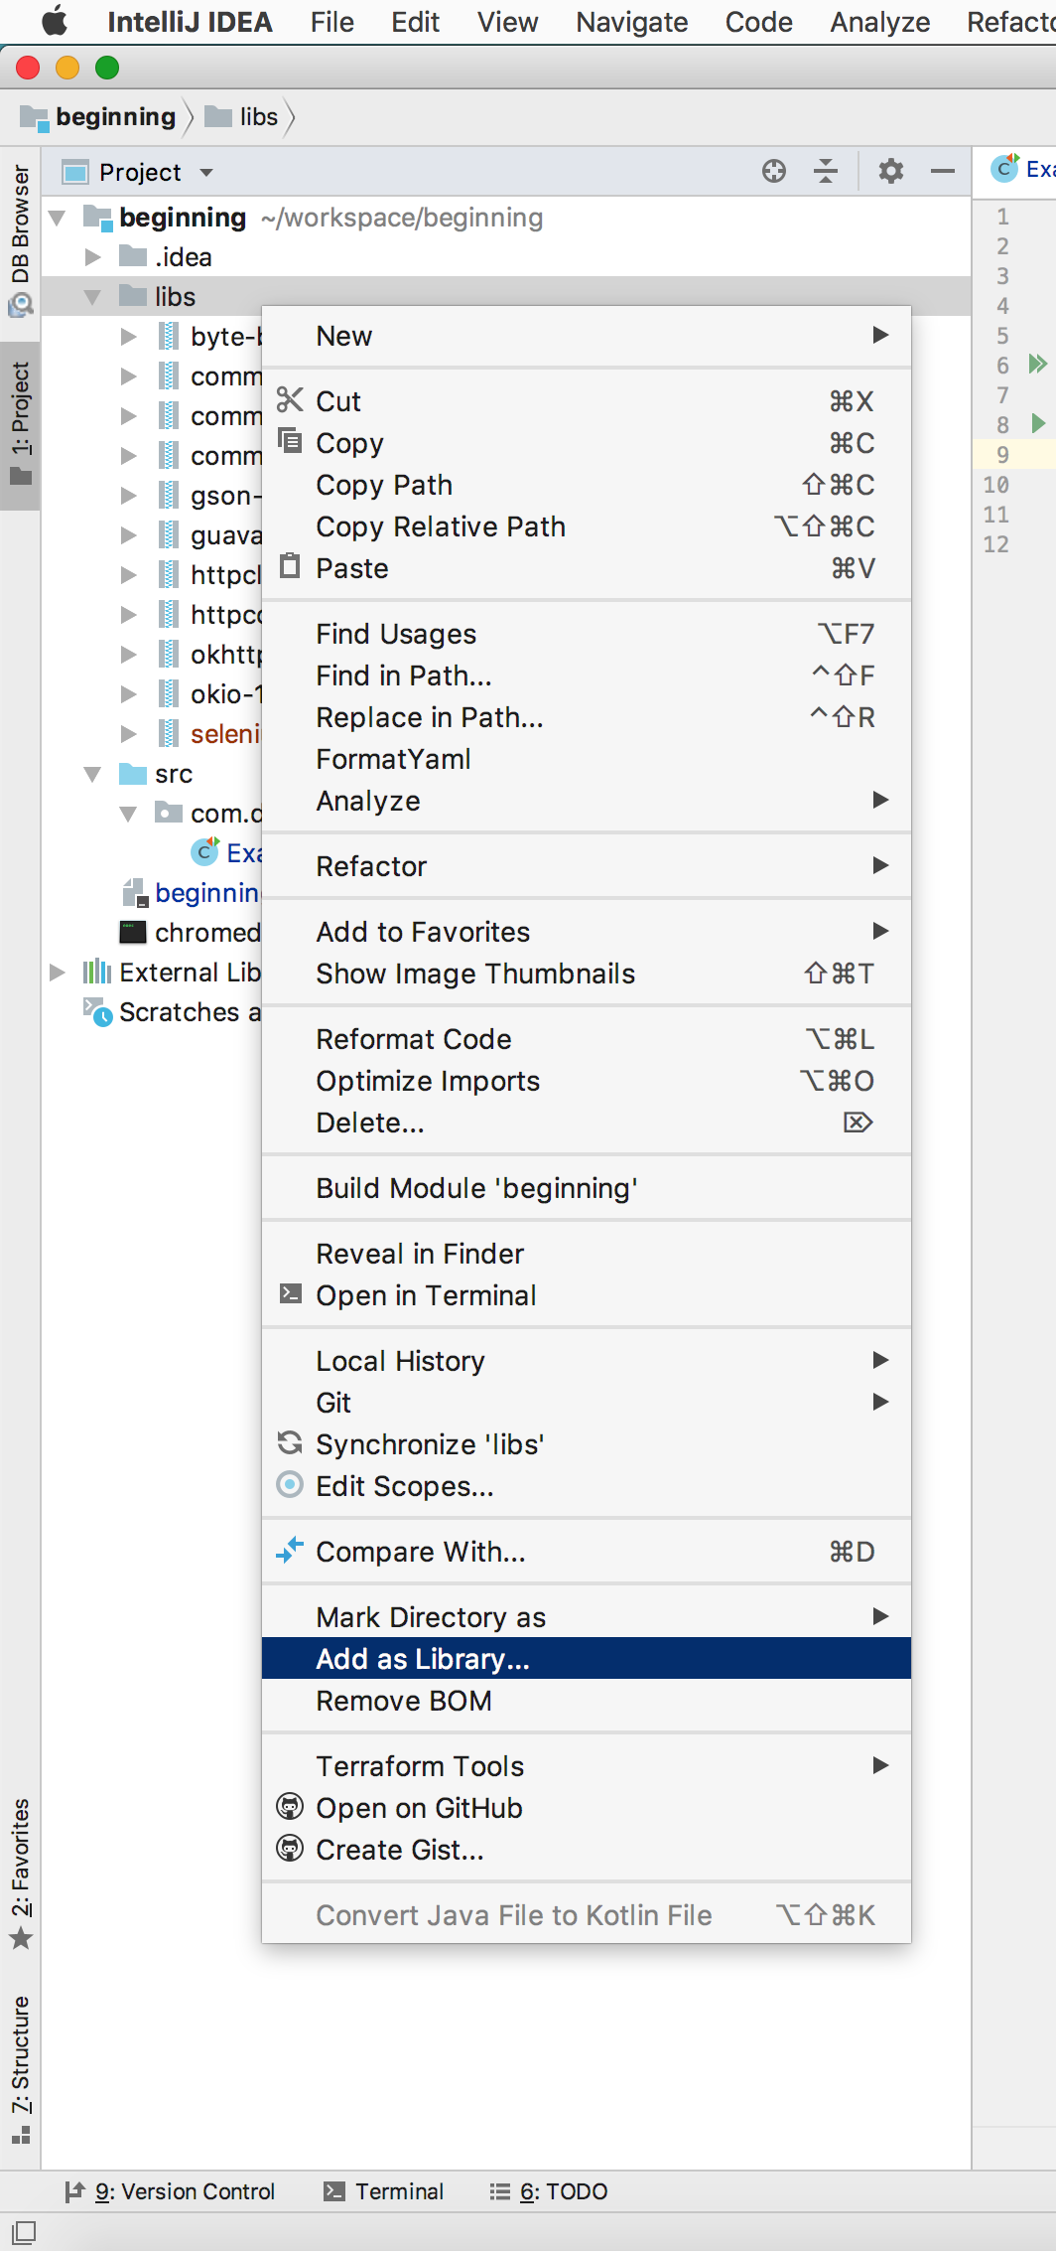
adding selenium libraries to the classpath
Notes:
Just because the Selenium libraries are in the projects libs/ folder, the Java compiler won’t be able to find them
The compiler will only look in the folders you tell it to
So we need to tell the compiler to look in the libs/ folder
Right click on the libs/ folder
Select “Add as Library…”

Slide 42
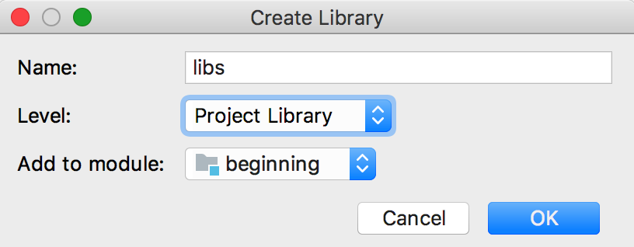
adding selenium libRaries to the classpath
The name libs will automatically be filed in because we right clicked on the libs folder
We want the entire project to be able to use Selenium
So we add it to the project level and we only have one module
So it automatically goes to the beginning module

Slide 43
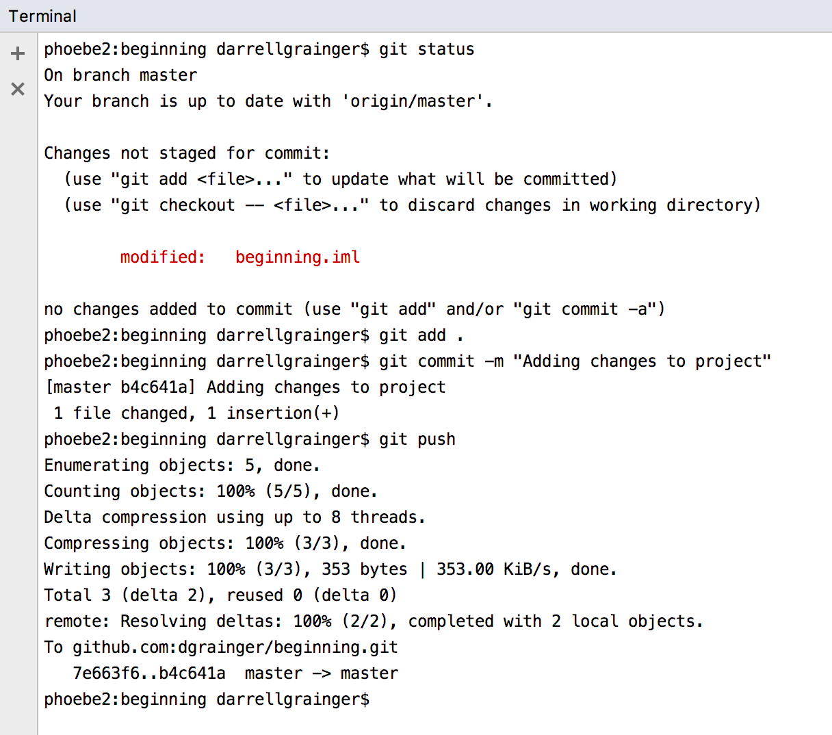
commit and pushing to local and github
Notes:
Again, as we done a couple of times,
We go to a terminal and see the git status has changed
The sequence is;
git status
git add .
git commit -m “some helpful message”
git push

Slide 44
TODO
Code completion - WebDriver (picture 35)
Automatically adding import statements
More code completion - ChromeDriver
Simple example
Running the simple example
Adding a .gitignore
Using the JUnit framework @Before and @After annotations
Using assertEquals statement for a pass/fail result
Seeing it fail then fixing the test
Adding a second test

Slide 45
checklist
A good book on Git: https://git-scm.com/book/en/v2
A cheatsheet and docs for Git: https://git-scm.com/doc
A good Java IDE: https://www.jetbrains.com/idea/
Java documentation:
http://www.oracle.com/technetwork/java/javase/documentation/index.html
Java Development Kit (JDK):
Go to documentation then select Downloads tab
Selenium currently works with JDK SE 8.0

Slide 46
checklist
sh (Bourne shell) or bash (Bourne Again Shell)
macOS
This is the built in shell or Terminal.app
Linux
This is the build in shell
Windows
Git-scm: https://git-scm.com/download/win
Cygwin: http://www.cygwin.com/install.html

